Slide 1
The Story is Done!
Now What Do I Do With It?
The Pros and Cons of
Traditional Publishing versus Self-Publishing
And other insights into writing as a profession
A presentation by Rose Marie Kern
Sponsored by Rio Rancho Enchanted Hills Library
December 3, 2023

Slide 2
Questions to Ask Yourself.
Why did you write this manuscript?
Who did you write it for?
What are your goals as an author?
Will this be it...or do you picture yourself as writing other books as well?
How do you define success?
The answers to these questions determine your next step.

Slide 3
What was your Motivation?
Money making opportunity
Career (Publication can enhance your status in some jobs)
Public Acclaim/Fame
Inspire or entertain people
Leave something personal behind for family/friends.
Have a story locked inside that just had to get out.
The fact that you just always wanted to do it and you did!

Slide 4
The Big Question
Is this book a One-Hit Wonder?
Or
Do you plan to continue writing?
What is YOUR definition of Success?

Slide 5
Changes in the World of Publishing
OLD DAYS – Only option was to write the manuscript, send it to a publishing house (or agent) and pray they liked it. If they did you were given a contract and became rich and famous.
( or you could always type something up on your typewriter and take it to a book binder then try and sell it out of the back of your car.)
Problems with that method:
Today we have only 5 really big Traditional Publishing houses left controlling 85% of the worlds English speaking book market:
Penguin Random House (40%) HarperCollins (20%)
Simon & Schuster (10%) Hachette Book Group (10%) Macmillan (5%)
Most of these groups took over and control others – like Harlequin and Doubleday

Slide 6
Today’s Publishing Options:
Traditional Publishing - Sent to one of the Big 5 or its subsidiary
Send your manuscript directly to the company or submitting through an agent
Small Publishing Houses – local companies and university presses
Hybrid Publishers – Author pays a company to handle all aspects of publication.
Concierge Publishers – Authors who want to self-publish pay experts for specific services
Self-Publishing – Authors do all the work of editing formatting, cover design, PR, etc...then use a company to print and distribute the books

Slide 7
Publisher
a person or company that prepares and issues books, journals, music, or other works for sale.
Traditional Publishing
The author completes a manuscript and writes a proposal, then submits it to a publishing house (or, if possible, have a literary agent do it for you).
An editor reads it to determine whether it’s right for that house and whether to reject or to publish it. If the publishing house decides to publish the book, the house buys the “rights” from the writer and pays an advance on future royalties.
The house puts up the money to design and package the book, printing as many copies as it thinks will sell; markets and finally distributes the finished book.

Slide 8
Traditional Publishing
Pros
Wide distribution and exposure
Placement in brick & mortar stores
Most offer an advance on the expected royalties (which is later deducted from the ongoing proceeds )
Publisher handles all editing, formatting, revisions & cover art
They have in house marketing power & support
Author reputation is enhanced.

Slide 9
Traditional Publishing
Cons
Publishers received thousands of query letters each year.
Query letters may not be answered for three to six months.
May take 18 months to two years for the book to be published and on the market.
Publisher has full control over the title of the book, content, formatting styles, and cover art.
Author has limited input into decisions
Pay royalties twice a year
Low royalty rates, between 6% and 15% of net sales
Many require that all submissions come through an agent.
Traditional Publishers retain rights to the content and possible future uses of the book. Getting the rights back is difficult to impossible.

Slide 10
Publisher
a person or company that prepares and issues books, journals, music, or other works for sale.
Hybrid Publishing
The author pays a professional company to handle all the elements needed to get his manuscript into print and distributed across multiple channels.
Authors maintain ownership over their rights and they direct how they want their property handled.
Book may be published in 3 to 6 months.
Once the book is published the author receives royalties of up to 40% of net sales.
Print and eBooks are distributed to bookstores, wholesales and libraries.

Slide 11
Publisher
a person or company that prepares and issues books, journals, music, or other works for sale.
Hybrid Publishing - Cons
Cost of having a Hybrid publisher do all the work begins around $3,000
Will charge more for each version of your book (print, ebook)
The company will market the book and send your royalties to you monthly. Authors may get only 10 to 20% of sales.
There are no guarantees of success
You have to research how dependable they are and whether they can follow through on their commitments.

Slide 12
“If you see yourself as the creative director of your books, from concept to completion and beyond, then you’re indie. You don’t approach publishers with a longing for validation: ‘publish me please’. You make partnerships that help you deliver the best possible book to the most possible readers.”
Orna Ross, Founder-Director of the Alliance of Independent Authors

Slide 13
Self-Publishing or “Indie” Publishing
Pros
You control all aspects of getting the book published including:
How/where it will be printed and distributed.
Manuscript and Cover formatting
Title and Cover Art
Pricing
Publication is almost instant
Easy to implement changes
Great royalty rates
Usually receive royalty payments from marketers once a month.

Slide 14
Self Publishing – Cons
Author is responsible for all editing, book formatting, cover art, and marketing.
Usually fewer sales
Greater potential to publish crappy books
All costs are upfront to the author
Author must do ALL their own marketing unless they hire others.

Slide 15
Concierge Publishers
Someone whose job is to help a writer with the process of publishing a book. An industry expert who assists self-published authors with services such as:
Editing the manuscript
Formatting the manuscript
Formatting the book covers
Obtaining ISBN’s, Legal Copyrights
Giving insights into marketing options
Setting the book up with a printer/marketer (ie: KDP Amazon, Bookbaby, Ingram Spark...)

Slide 16
Other decisions for self-publishing authors:
Print Book – Hardback or Paperback
Can be sold at readings, speaking gigs & book signings
Tactile experience for readers
49% of readers prefer print
Print on Demand eliminates inventory & fulfillment issues & costs
eBook
Minimal production costs
Affordable distribution-global reach
Instant delivery to & highly portable for your readers

Slide 17
Key tasks the self-publisher needs to know and do:
Define your target audience
Create a detailed content outline
Research content then write the manuscript
Have the manuscript edited
Choose a self-publishing option, then hire a printer/marketer, such as Create Space, Ingram Spark, KDP Amazon, Book Baby or I Universe
Learn the business aspects of becoming a writer. (ISBN’s, Copyrights, etc.)
Set cover price and publication date
Have manuscript’s interior pages designed and formatted
Create, or hire someone to create, front and back covers
Develop press materials
Plan and implement a comprehensive marketing, public relations, and advertising campaign

Slide 18
Pre-Publishing
You may think the book is complete, but it is NOT
Developmental Editing – Looks at the big picture, the organization ans strength of a book including characters, pacing, point of view, tense, subplots and dialog.
Edit for Content – inconsistencies in characters, timeline, locations.
Line editing- issues in spelling, grammar, word choices. Looks for weakness such as overuse of a word, unnecessary adverbs, overly long paragraphs. Each line of the story is viewed critically.
Beta readers – people you ask to read the book either for general opinions or for specific content (i.e. descriptions of a place or event)

Slide 19
If you wait until you’re done (writing) before you do the marketing, you’ve waited far too long.
Seth Godin

Slide 20
Normal Stages of Book Marketing
Before you write a book
While you are writing a book
After the book is written
After the book is published.

Slide 21
Who would want to read your book?
(and don’t say “everyone”)
There are different audiences for Fiction and Non-Fiction and even within those two general categories lie a wide variety of reading tastes.
Example Genre: Fantasy
Reader Preferences could be:
Culturally oriented: American, mediterranean, Nordic, Egyptian, Hindi, Oriental
Time period: Current, historical, futuristic
Tone: Dark Fantasy (zombies, vampires), Bright Fantasy (fairy princess), Post-apocalyptic,
Children’s Fantasy (Peter Rabbit), Steampunk, SciFi Fantasy (Dr. Who)
Young at Heart Fantasy (Grinch Stole Christmas, Willy Wonka), Romantic Fantasy
Sexual Fantasy, Adventure Fantasy (Indiana Jones),
Knowing your audience allows you to design your marketing (and book
cover) in a style that is calculated to attract that particular group of buyers.

Slide 22
The Title
Authors frequently have a “working title” in their mind, but they should be researched and considered from many angles before a final title is selected. Here are some examples of book titles that were changed before publication
Jacqueline Susann’s They Don’t Build Statues to Businessmen became Valley of the Dolls
George Orwell’s The Last Man in Europe became 1984
William Golding’s Strangers from Within became Lord of the Flies.
Carson McCullers The Mute became The Heart Is a Lonely Hunter.
Ernest Hemingway’s Fiesta became The Sun Also Rises.
Evelyn Waugh’s The House of the Faith became Brideshead Revisited.
Alex Haley’s Before This Anger became Roots: The Saga of an American Family.
Carl Bernstein and Bob Woodward’s At this Point in Time became All the President’s Men.

Slide 23
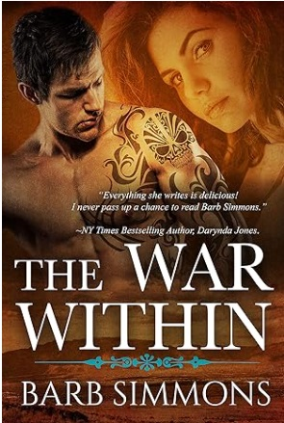
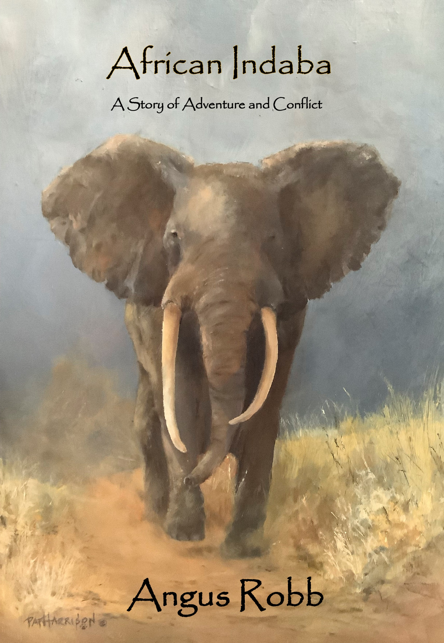
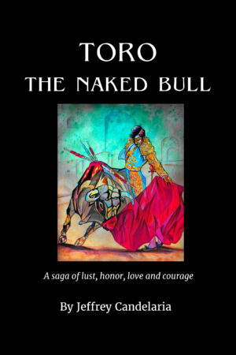
Titles and Cover Art should Intrigue, but not overwhelm

Slide 24
Marketing Your book
Whether you decide to go with Traditional Publishers or the Indie Route – here are a few things you need to do:
Step Number 1 - Create Your “Elevator” Pitch
In 50-80 words get me excited about your book!
A strong elevator pitch makes it easier for you to answer, “What’s the book about?”

Slide 25
Elevator Pitch vs Synopsis
An Elevator Pitch is a very short sentence that can entice either a potential agent/publisher or your intended audience in the time it takes an elevator to travel between floors. It must grab the target’s attention enough for them to want more.
A Synopsis is a brief summary of the major points of a subject or written work or story. This one or two page carefully crafted breakdown of your plot exists so an agent can assess whether you have an effective, satisfying plot. Don't worry about spoilers - the whole point of the synopsis is so the agent can see where the plot is going. It sets the tone for advertising the final product.

Slide 26
Examples of Elevator Pitches – Guess the Book
Lord of the Rings
When Thorin Oakenshield and his band of dwarves embark upon a dangerous quest to reclaim the hoard of gold stolen from them by an evil dragon. Gandalf the wizard suggests an unlikely accomplice: Bilbo Baggins, an unassuming Hobbit dwelling in peaceful Hobbiton. Along the way, the company faces trolls, goblins, giant spiders, and worse.
The Da Vinci Code
While in Paris on business, Harvard symbologist Robert Langdon receives an urgent late-night phone call. The curator of the Louvre has been murdered inside the museum with a baffling cipher found next to the body. A trail of clues hidden in the works of Leonardo Da Vinci lead them to the murderer.
The Gigalos
TIRED OF PAYING ALIMONY? I WILL MARRY YOUR EX-WIFE. (1-800-555-5555) If you can pay the price, these men guarantee you will escape paying for your past “mistake”. What happens when the women catch on?

Slide 27
More Examples of Successful Elevator Pitches
The League of Gentlewomen Witches, by India Holton: "A witch who is as proper as a Jane Austen heroine and a pirate who is no Mr. Darcy race across Victorian England in a flying house, pursuing an enchanted amulet, while being chased by people determined to stop them.
Anybody Home?, by Michael J. Seidlinger: "A seasoned home invader teaches new invaders how to not only pull off a home invasion but also deliver a performance that invades the collective consciousness.“
Balloon Dog, by Daniel Paisner: "A darkly comic tale of longing and legacy and letting go, Balloon Dog tells the story of a brazen art heist gone sideways and asks readers to consider what it means to leave a mark and what it takes to be swept up in the same currents that move the rest of the world.“
The Sweet Goodbye, by Ron Corbett: "A gritty, noir story that plays out in a forgotten America. Memorable villains, a twisting plot, and a hero with as much brain as brawn.“
Knot Again, by Kwana Jackson: "Harlem firefighter, Lucas Strong feels like he can only find any peace and quiet at the local laundromat, where every day is rinse and repeat—until a fateful run-in with his high school crush."

Slide 28
Before Launching Your Book – make a plan.
Most authors begin building their reputation as an author before they have a book to sell by writing and submitting articles and short stories. After the books start coming, you can still use this both for publicity and for personal writing improvement.
If you are going with a traditional publisher they will research what else you’ve written before offering a contract.
If you are self-publishing, determine how much marketing you can do yourself and what you will need help with.

Slide 29
Suggested Marketing Options
Get a Website OR become part of an established author’s group that offers your own page on their website. Update it frequently.
Become familiar with the concepts of:
Metadata is defined as the data providing information about one or more aspects of the data; it is used to summarize basic information about data that can make tracking and working with specific data easier.
Keywords – search engines use these to pair the customer to the product.

Slide 30
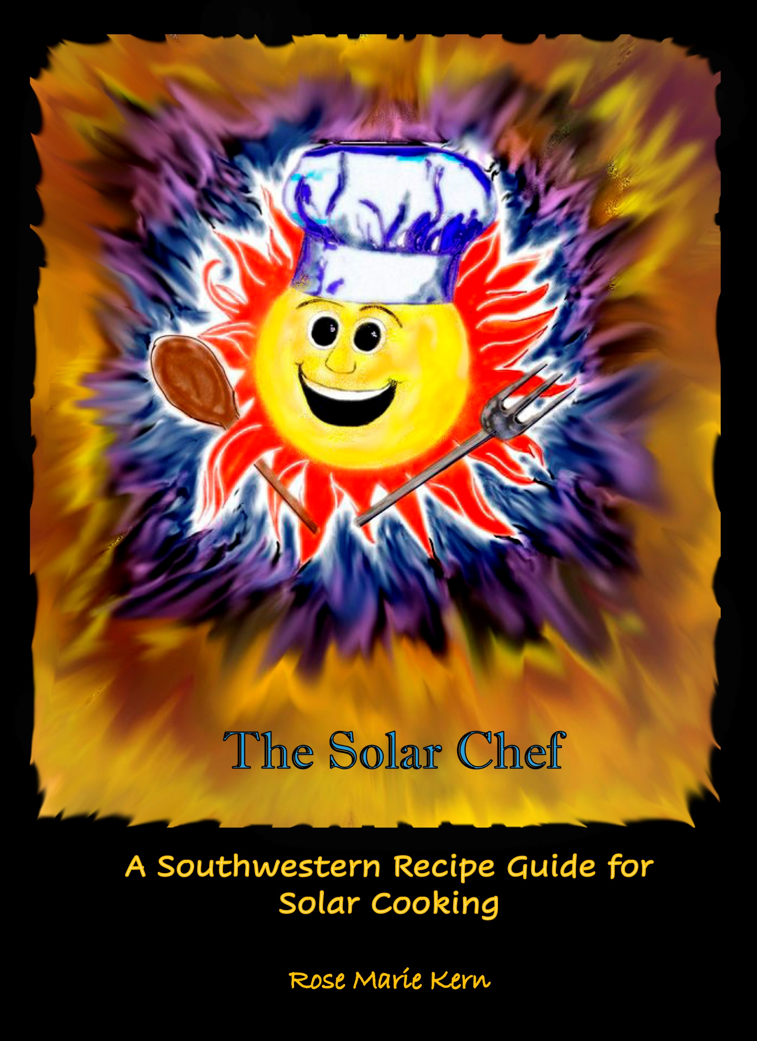
Keywords: Words or short phrases that describe your book
Examples of keywords for “The Solar Chef”
Sustainable Living
Organic
Gluten Free
Recipes
Cooking with Sunlight
Disaster
Off the Grid
Homesteading
Survival
Urban Prepper
Self Published book which has sold almost 9,000 copies worldwide.

Slide 31
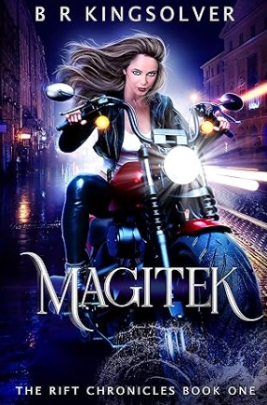
Keywords: Words or short phrases that describe your book
Urban Fantasy
Post-apocalyptic
Arcane
Woman scientist-magician
Survivalist
Tantalizing
Risk Taking
Futuristic
Self-Published book by BR Kingsolver who earns more than $30K in royalties annually off of his 6 different series – swears by ebooks.

Slide 32
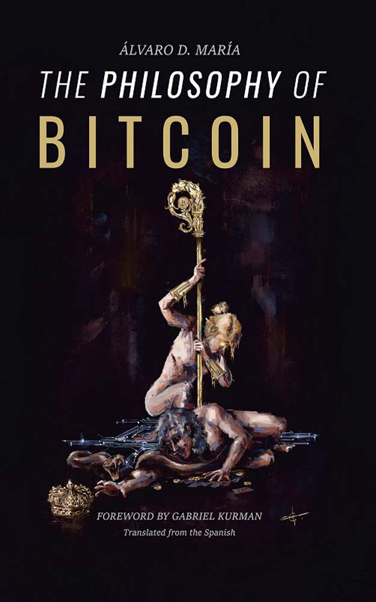
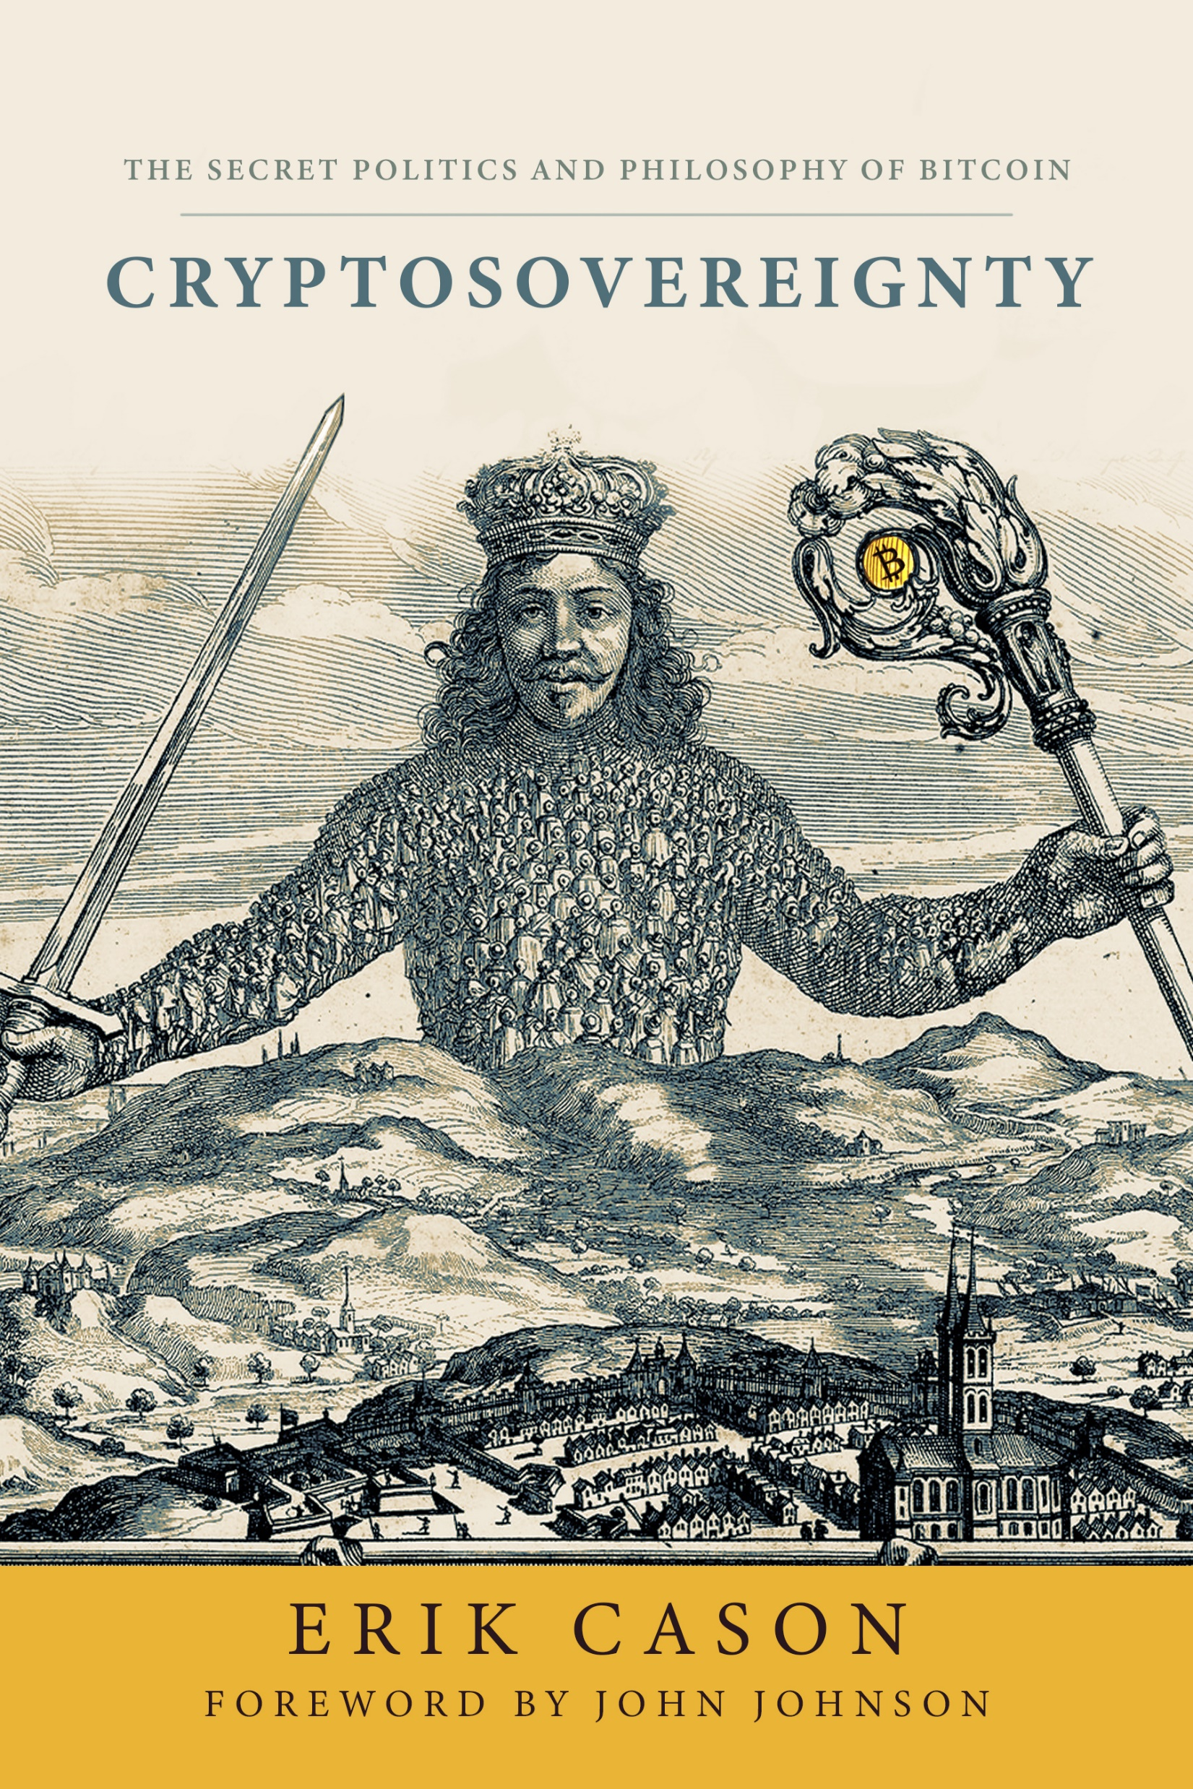
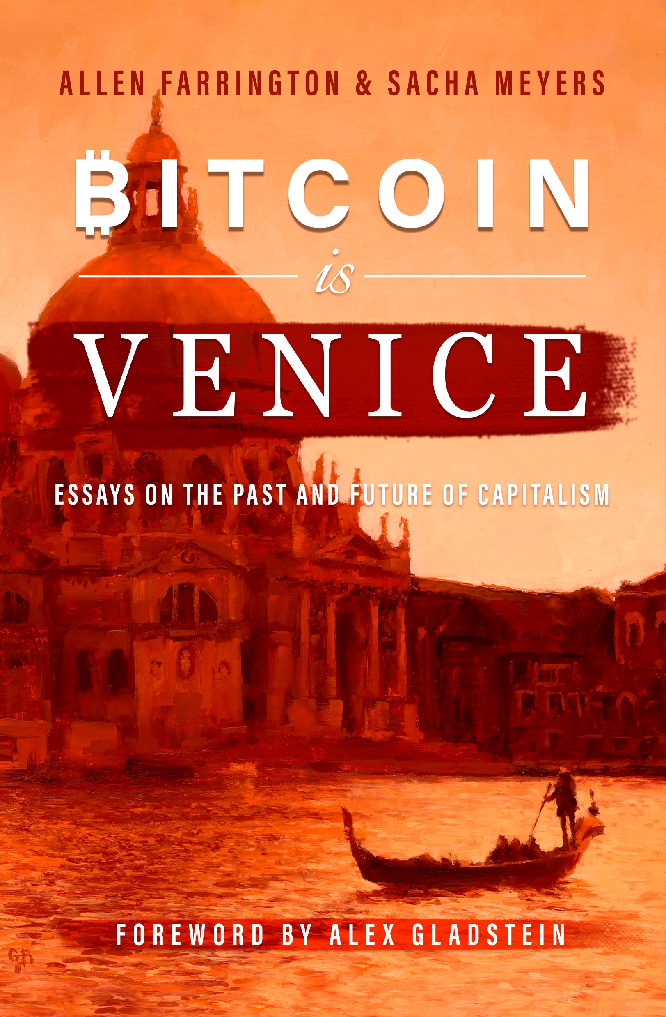
Client – BITCOIN Magazine
Self-Publishes using Amazon and 48 Hour Books
Marketed through big conventions and their website.
Each sold over 1,200 books in the first month of their release.

Slide 33
Tooting Your Own Horn – Free or Low Cost Options
Build or buy an email list – then send out information about yourself and the book on a schedule.
Get a website/Blog or:
Use every free author’s page offered by your publisher, writer’s group, Amazon, Goodreads, etc.
Use social media: Facebook, Twitter, Instagram, Linkedin etc...
Send your book to local book reviewers in your community (newspapers)
Schedule and publicize reading/book signing events focused on your genre. Do interviews on podcasts, radio or tv local shows.
Enter the book or related short stories in writing contests.
Look around for groups that may find your book useful (best for non-fiction or children’s books which teach)

Slide 34
Tooting Your Horn, continued.
Write short stories and/or articles for newsletters and magazines – regardless of whether they will pay you or not.
Every one that is published should include your name and a 50 word biography that includes the title of your latest book.
Send your hometown newspaper information about you and your book.
Give lectures about writing for other writer’s groups, or if your book contains non-fiction items find groups who want to know more. For example:
Memoirs based on a specific event, profession, sport or war.
Craft/Hobby book – give classes about that craft
Travel books – give presentations or write articles about those places.

Slide 35
Paid Advertising
Ads in appropriate newspapers, magazines.
Flyers
Business cards
Bookmarks with your Book information.
Rent space at Arts/Craft shows, Sci-Fan Conventions, aviation shows, book fairs etc.)

Slide 36
Continue Learning about the art and industry of writing and the business aspects of being an Author.
Figure out what you don’t know.
Read writer’s magazines and journals
Attend writing conferences, classes, seminars and workshops
(NOTE: Check out UNM-Continuing Education)
Join writer’s groups.
Genre oriented (LERA, Croak & Dagger, Scbwi, etc...)
Non-genre specific (SouthWest Writers, Author’s Guild).

Slide 37
Associate with other writers
Join a critique group –
It is often easier to see errors in others writing than it is in your own.
Learn how to take criticism, judge its value and accept or reject it without inserting rancor or becoming defensive

Slide 38
Writer
Anyone who writes.
Author
Distinguished professional writer who has published and sold their work.

Slide 39
Learn the Business Side of Writing
Money Management
Taxes and Tax Deductions: (home office, travel etc)
Rights and Copyrights
ISBN/Barcode options
Marketing/Advertising
Self-Promotion

Slide 40
Types of Printer/Marketers (NOT Publishers!)
KDP Amazon. www.kdpamazon.com
Largest printer/marketer in the world. Can release your book worldwide or to target markets. Free set up, free ISBN. Easy website. No other marketing options offered.
Ingram Spark. www.ingramspark.com
Printer Market who also sends catalogs to libraries, bookstores, universities.
Occasional set up fees. Can provide other services for a fee. Website is tricky.
48 Hour Books www.48hrbooks.com
Primarily a printing company that gives some help with book formatting. Better option for bulk purchase by author or author’s clients.

Slide 41
Suggested Resources:
Writer’s Digest Monthly Magazine (Print) www.writersdigest.com
Poets and Writers Magazine (Print) www.pw.org
Author’s Publish – online magazine and source of information about publishing sources
www.authorspublish.com

Slide 42
The Writer’s Market contains information on traditional publishers in the U.S.
Covers national, regional, state, and local publishers, agents, magazines, contests and awards.

Slide 43
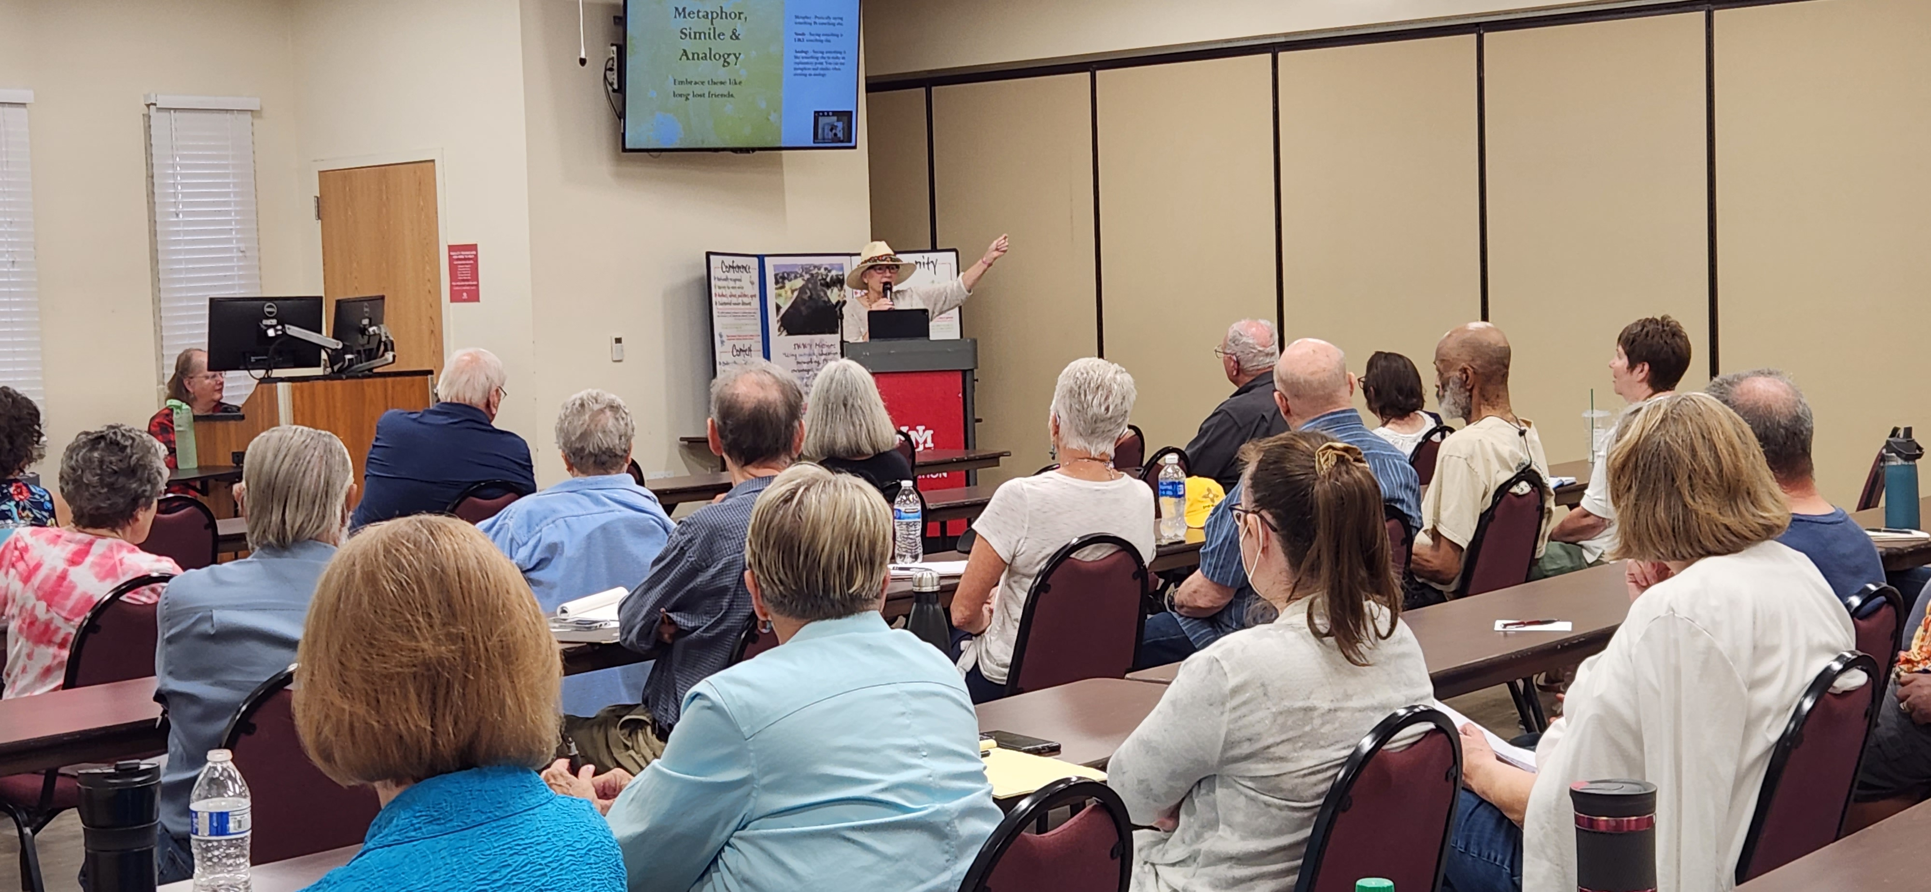
Largest writing organization in the southwest.
2 meetings with free presentations/month, plus local workshops & classes – both in person and zoom.
Annual Short Story and Poetry Writing contest
Fabulous website filled with videos, interviews of authors, members webpages and opportunities for members to market their books.
Award winning newsletter with information for authors and publishing opportunities.

Slide 44
www.southwestwriters.com
From Writer to Author
With Rose Marie Kern & Cornelia Gamlem
Saturday: December 9, 2023
12:30 – 2:30 pm (MST)
In Person at the UNM-CE building & via Zoom
SWW members: $20 ♦ Non-members: $30
The publishing industry and terminology
The business side of writing: Taxes, legal, technical aspects
The Marketing side – identifying your target audience
The Craft of Writing

Slide 45
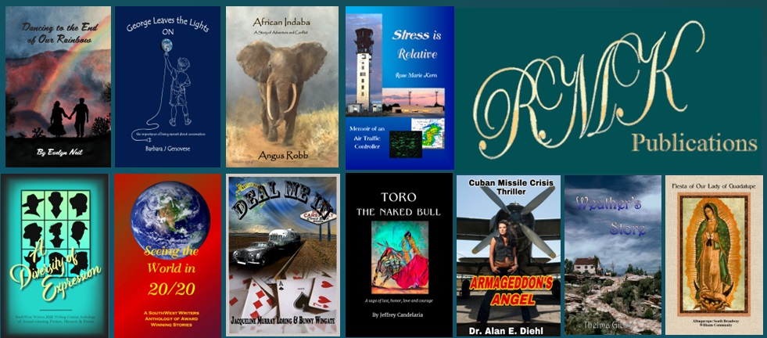
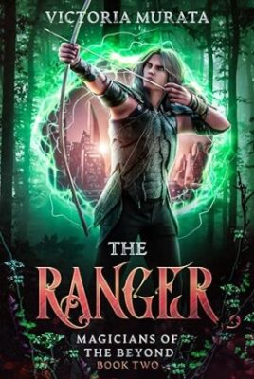
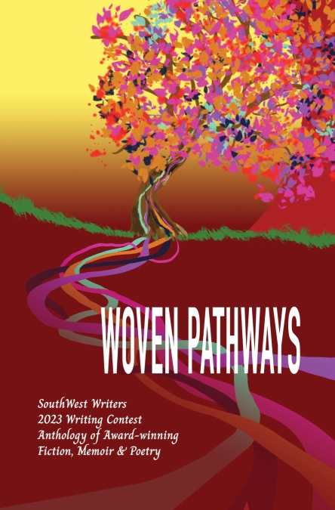
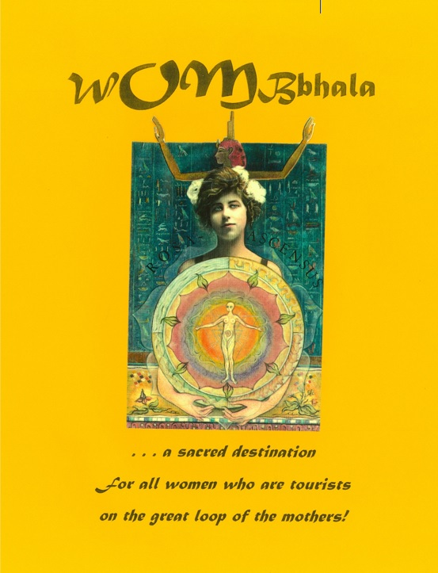
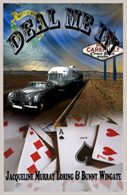
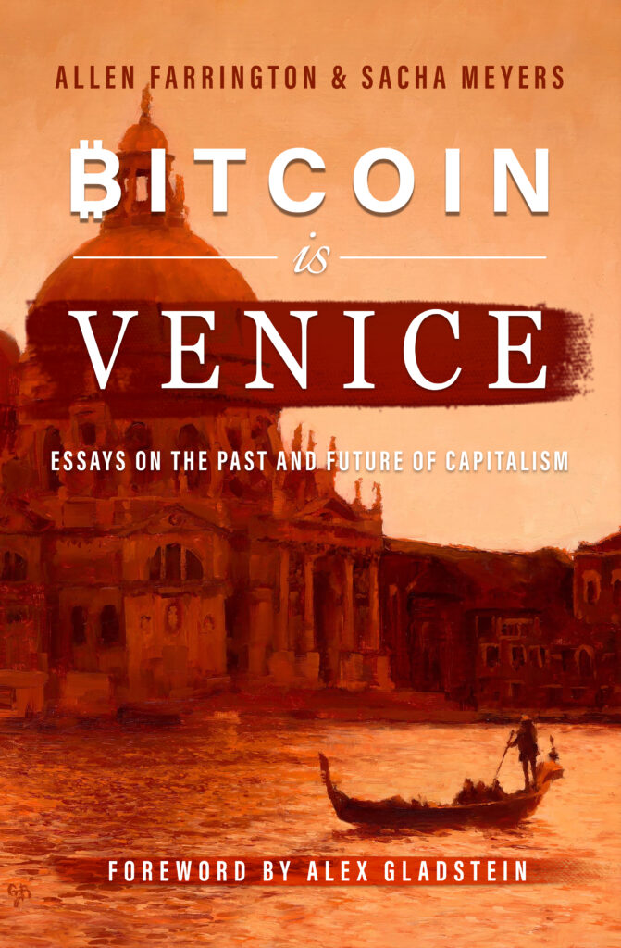
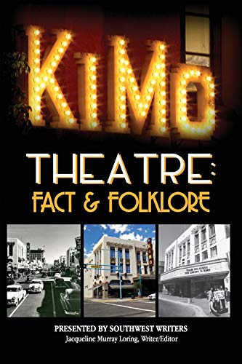
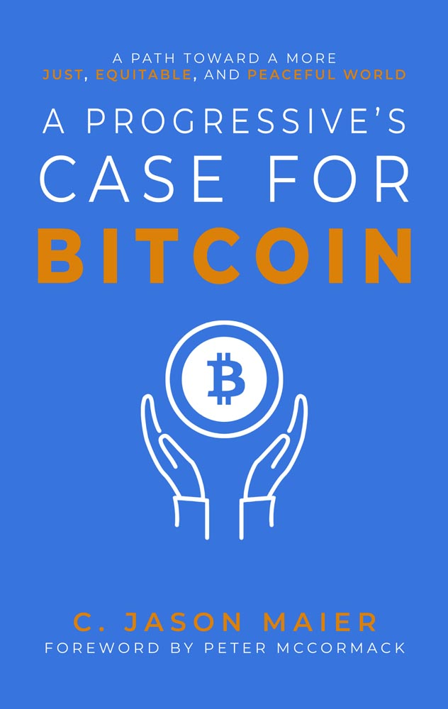
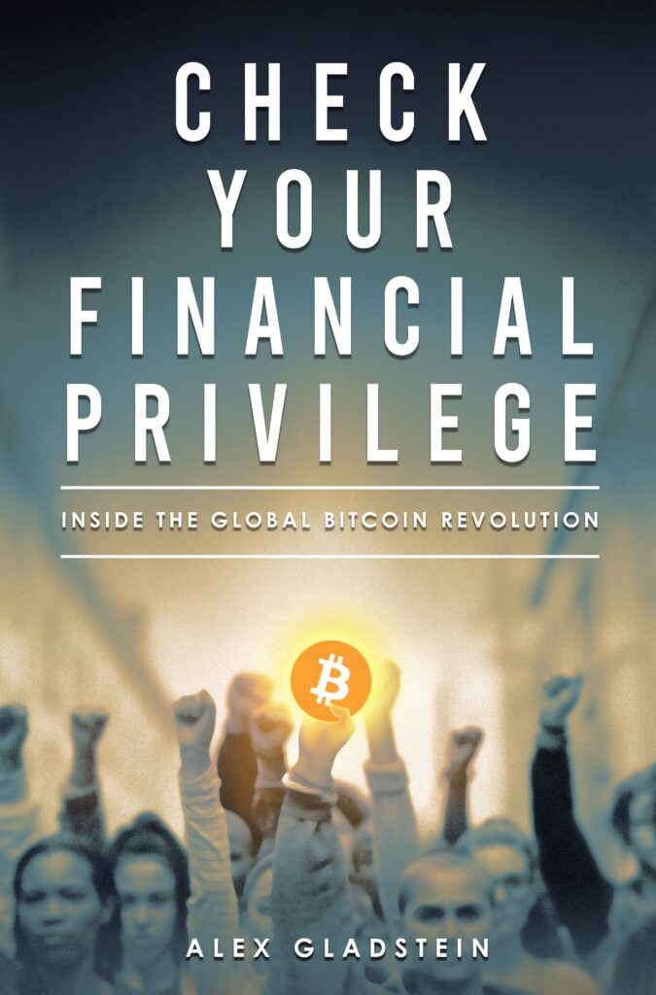
This presentation has been sponsored by the Rio Rancho Library.
For More Information:
Rose Marie Kern
author@swcp.com
www.rmkpublications.com

