Slide 1
From Writer to Author
The Professional Journey
A SouthWest Writer’s Workshop
Presented by
Cornelia Gamlem & Rose Marie Kern

Slide 2
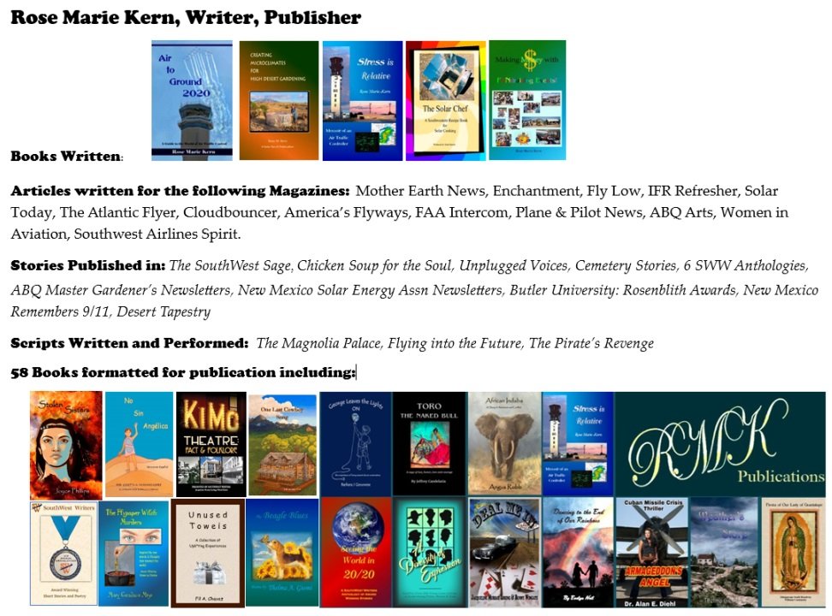

Slide 3
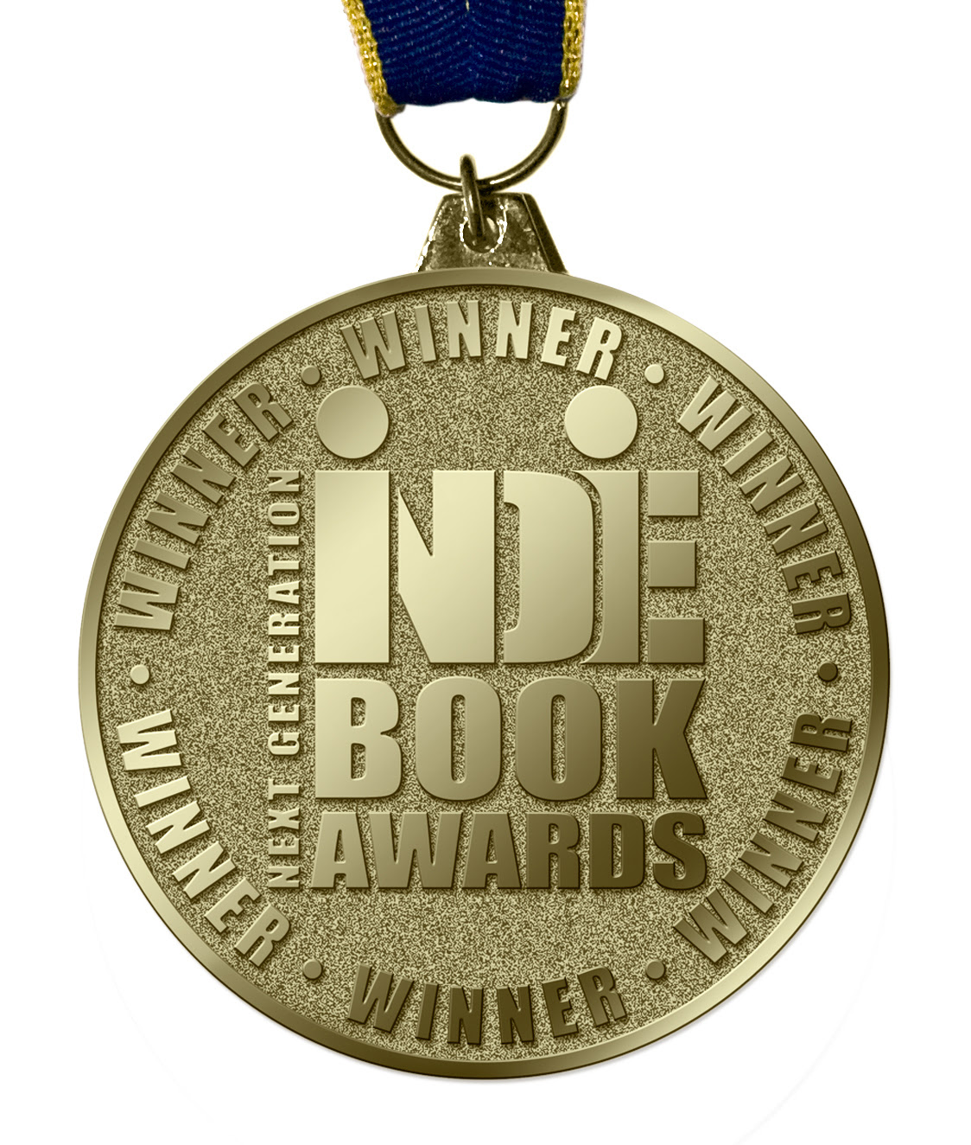
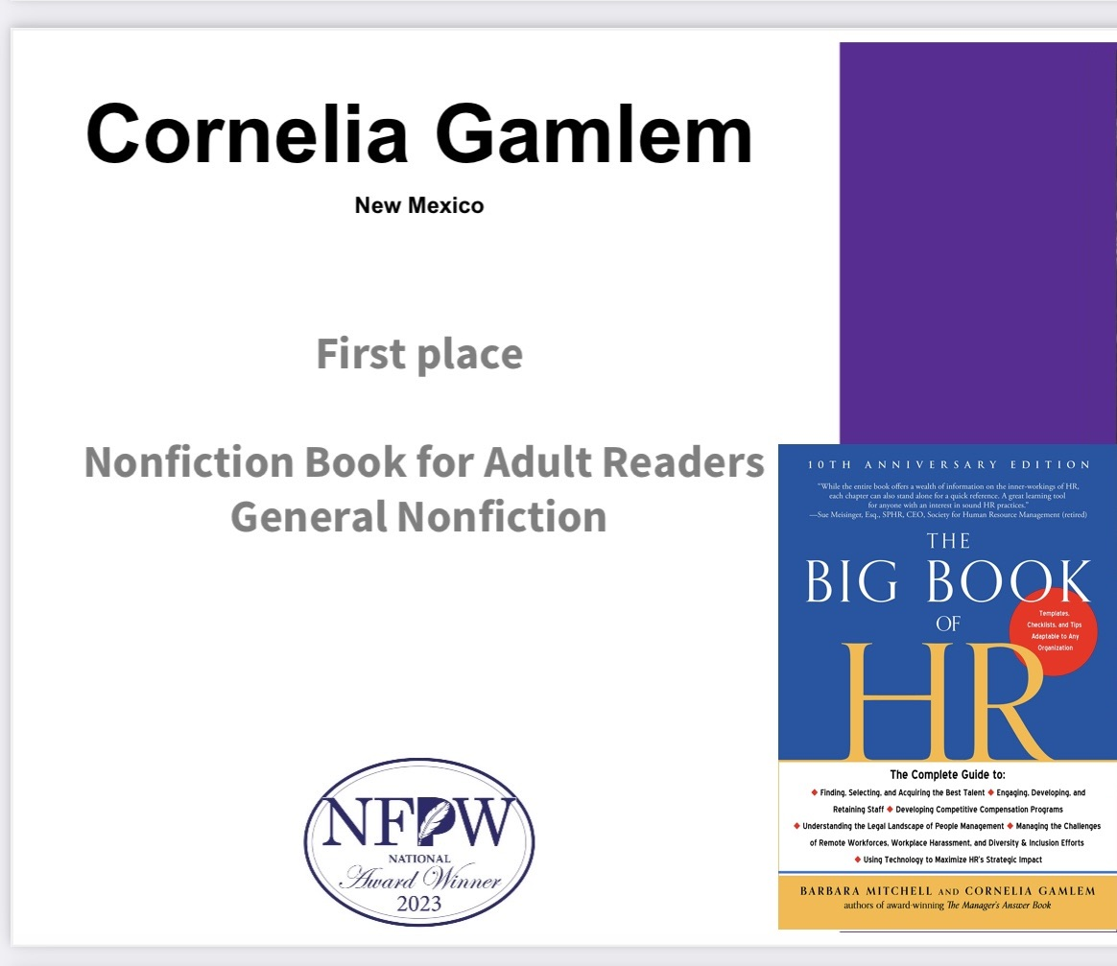
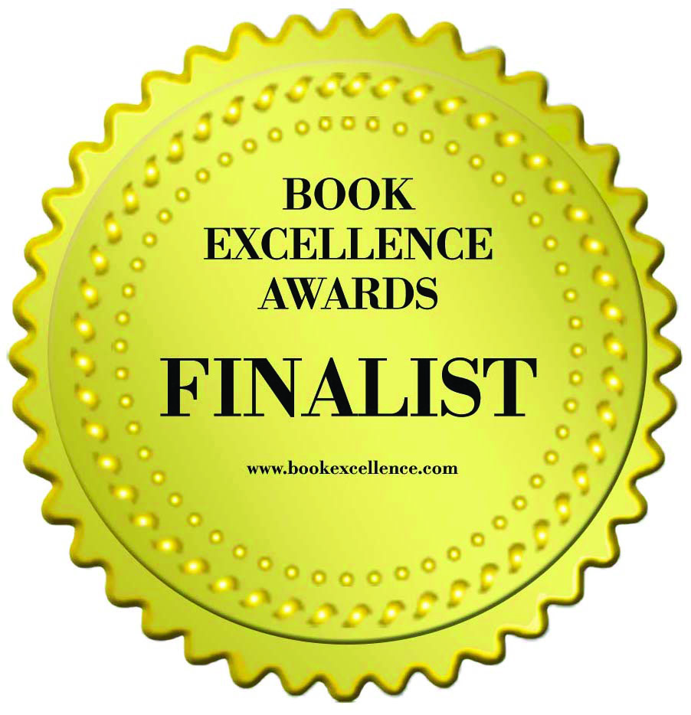
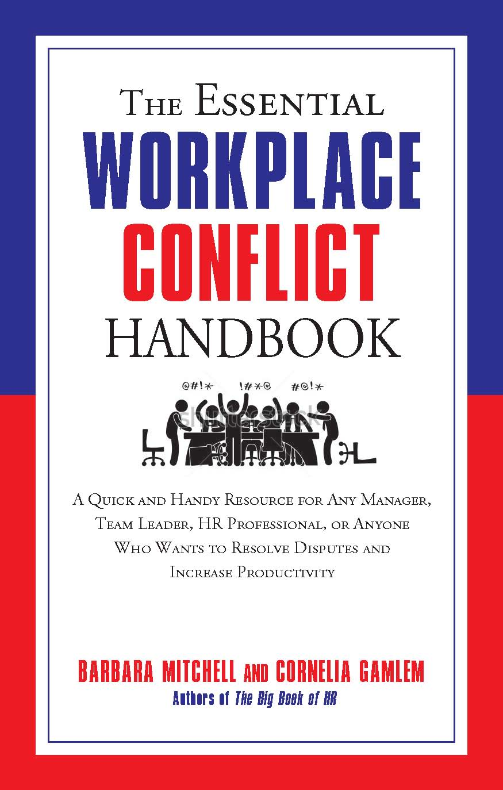
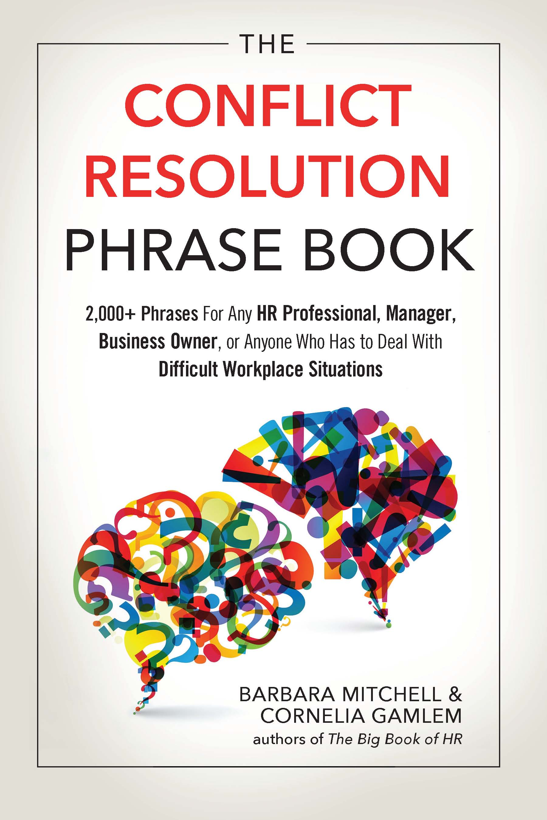
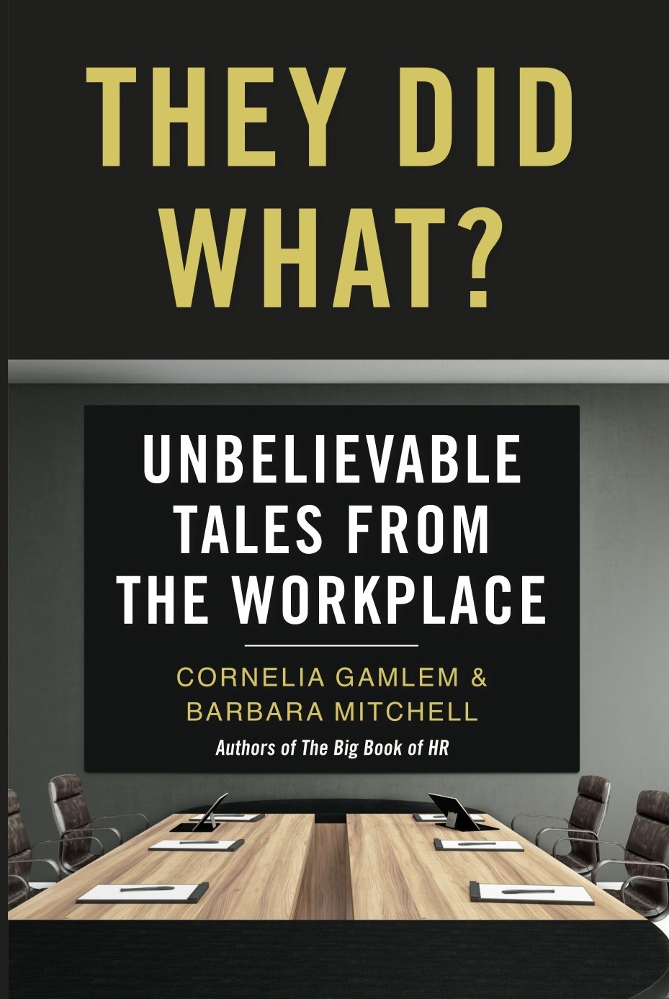
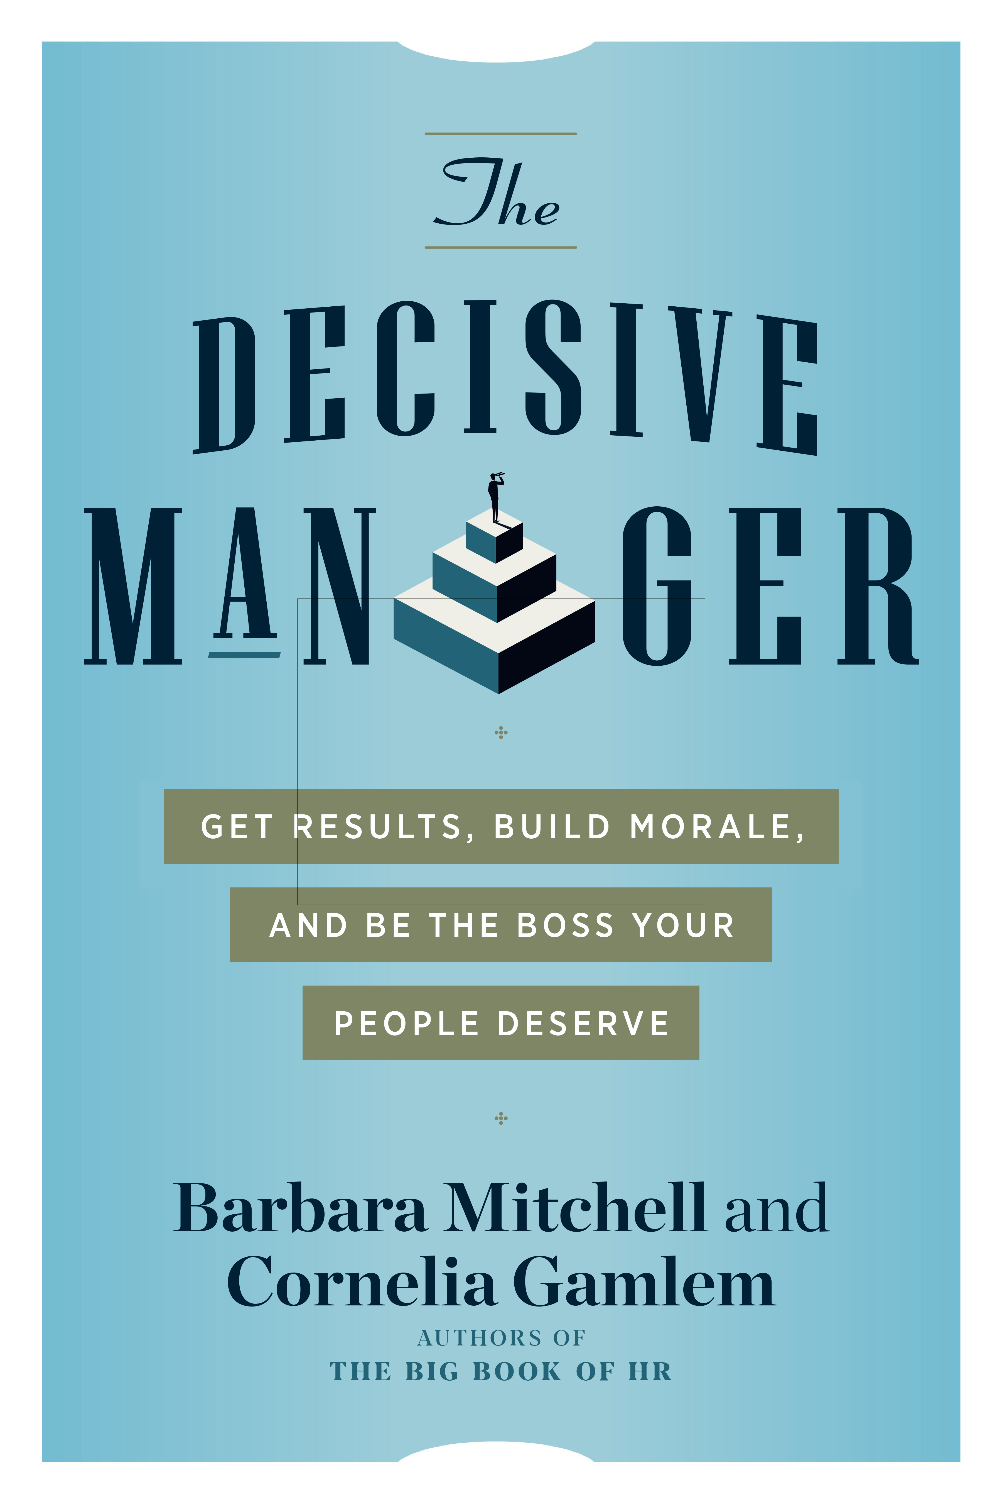
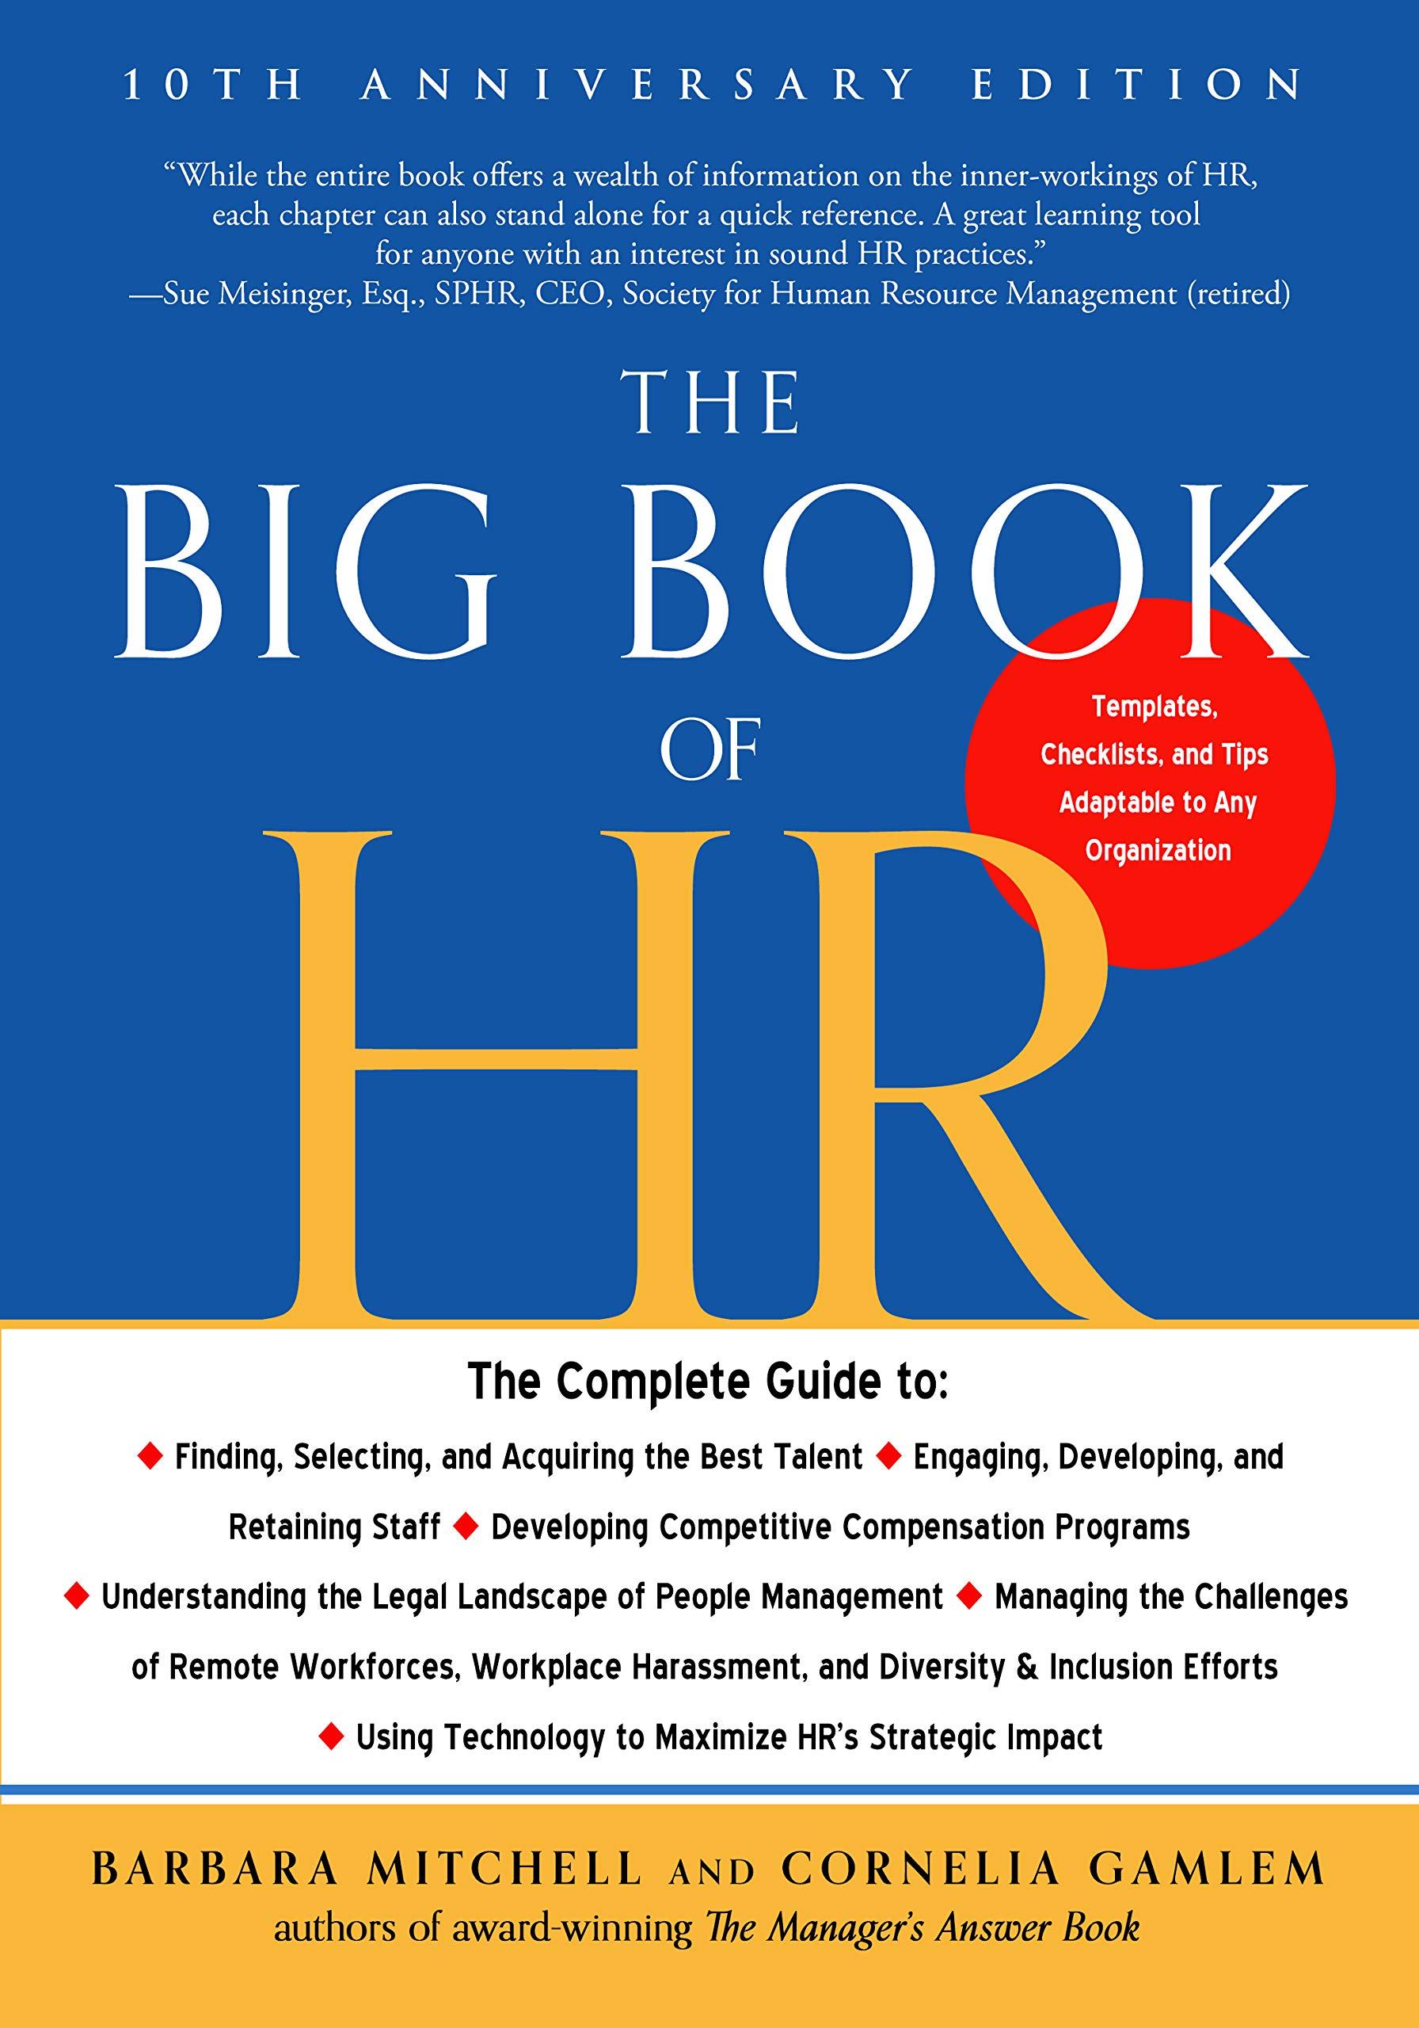
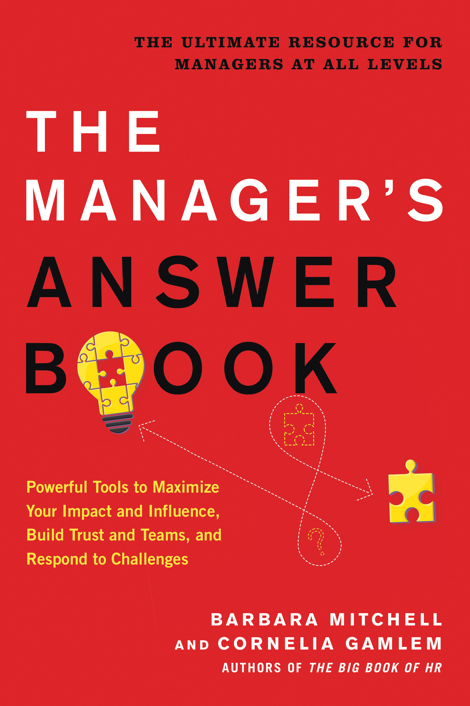
Cornelia Gamlem, Author, Consultant, Speaker
Cornelia has been writing throughout her career, starting with articles for corporate and professional publications. In 2012, she co-authored her first book with her colleague Barbara Mitchell. Throughout her career, she has been quoted in and written articles for numerous publications. She is also a frequent guest on podcasts and radio as well as a webinar presenter.
In addition to the awards she has received for her books and articles, her books have been named to many business “must-read” lists.

Slide 4
What We’ll Cover
Writer versus Author
What kinds/styles of writing do you want to pursue?
Identifying your target audience
Planning for your BOOK

Slide 5
What We’ll Cover
What authors need to know
Publishing industry
Types of publishing & considerations
Terminology
Your marketing plan – from launch to finish
The business side of writing
Taxes, legal, publishing support, technical aspects
Life-long learning tips

Slide 6
From the Dictionary
Writer
Can be anyone who writes anything
Author
A distinguished and professional writer
who has published and sold their work
What defines professional?

Slide 7
Before You Begin Writing
Consider: WHY you want to write?
You enjoy writing
You have great stories/poetry/insights to share
Public Acclaim/Fame
You want to raise your credibility or expand your business
You want to make some money doing it
You just always wanted to do it!

Slide 8
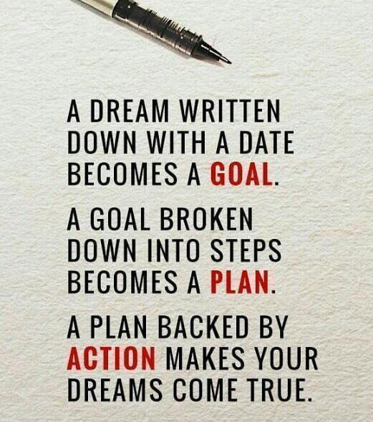
What Types/Styles of Writing are You Drawn to?
Essays, Articles
Technical writing, freelance, ghost writing, magazines,
Short Stories
Poetry
Genre: e.g. Haiku, Free Verse, Sonnets
Playwriting/TV & Movie scripts
Books
Fiction (including genre)
Non-fiction, creative non-fiction, memoir, inspirational
Children, young adult

Slide 9
Essays, Articles, Short Stories, Poetry
Can be marketed to magazines and newsletters, or you can combine many into books.
The average short story should run anywhere from 5,000 to 10,000 words, but they can be anything above 1,000 words.
Flash fiction is a short story that is 500 words or less.
Poetry varies according to form.
Haiku is 9 words total.
Some narrative poems are as long as short books.
Magazine Articles – Normally about 1,000 words. Feature pieces can be 3,000 o 5,000. Frequently accompanied by photographs/artwork which may be provided by the author or the magazine.

Slide 10
Classifications of Books
Flash Fiction – Under 1,000 words
Short Story – 1,000 to 7,500 words
Chapbooks – Short book of verse or poetry. Usually less than 40 pages. (No spine.)
Novelette – Verse or poetry 7,500 to 17,500 words
Novella – Verse or poetry 17,500 to 50,000 words
Novel – 80,000 – 100,000 words is standard for fiction.
Epic Saga – over 175,000 words
Young Adult (YA) novels – 40,000 to 80,000 words
Middle Grade Books (8-12 years) 20,000 to 50,000 words
Children’s book (7-8 years) 1,000 – 10,000 words
Picture book for young kids. 500-600 words

Slide 11
Recommended length of books by Genre
Thriller/Mystery Fast Paced 70K – 90K words
Science Fiction & Fantasy – 90K-120K words
Romance – 50K to 90K words (Today’s audience prefers fast, fun reads)
Historical fiction - hovers around 100K words
Non-Fiction/Memoirs – 80K – 90K words
Other Non-Fiction – Varies wildly according to category of book. These can be travelogues, business manuals, histories, research, reference books etc...

Slide 12
Type of “Books” on the Market
Paperback – Standard for novels, memoirs, etc. Usually 80K-130K words. Most popular sizes include: 5x8, 5.5x8.5, 6x9, 8x10.
Hard cover - Smallest is usually 6x9, many are 7x9 or 8x10. Popular for Library reference books, genealogies.
Coffee Table books – large hardback books. Contain many photos and text. Sizes are normally larger 9x12, 10x12, 12x15
Spiral Bound – Cookbooks, Reference books, workbooks
Ebook – Can be read on most computers, cell phones, kindle readers etc.
Audible – A digital recording of someone reading a book aloud. Requires a recording studio and usually a professional reader, then is packaged and sold online or can be digitized to a CD and sold in stores.

Slide 13
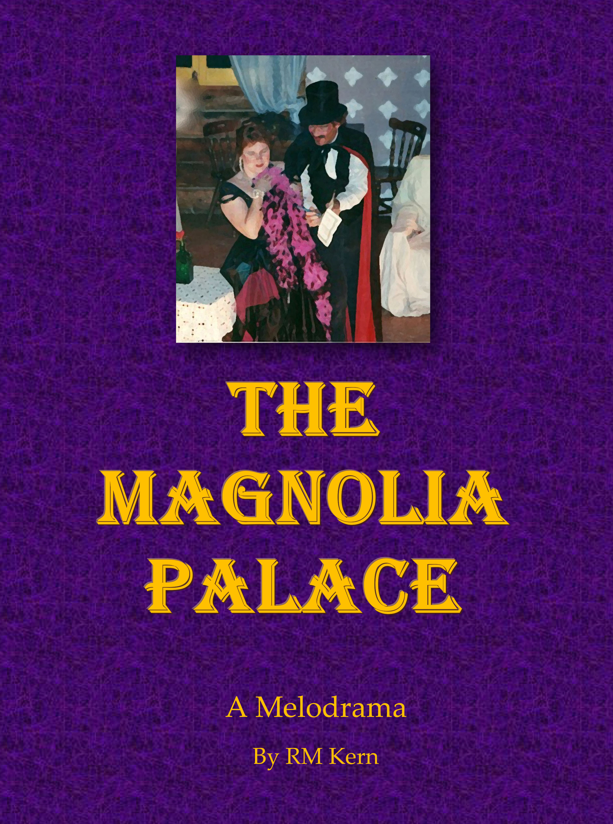
Stage Playwriting
Playwriting is the art of crafting a dramatized narrative for a theater production.
Start by working with local non-profit theaters – either as an actor or in a support position: Props, stage hands, costumes, lighting, etc...
Take theatre and acting classes – not because you want to act, but because you want to know how to create characters and situations that will work on stage.
Find and become familiar with the way scripts must be formatted.
Local theaters are more open to new scripts.

Slide 14
Movie and TV Screenplays
Must be written in a specific style. Formal education is recommended.
Usually start with shorter works. Enter into festival and contests.
Write scripts for various productions (tv shows, movies, commercials, etc..)
Standard Movie Scripts – between 90 & 120 pages (1.5 to 2 hour runtime)
1 minute of screen time= 1 page
Less “talking” than a novel.
Create elaborate and descriptive scenes that take only a few minutes on screen.
Detail the moods and qualities of characters – more expression – less dialogue.
Include shot, lighting and camera instructions
Helps if you can be on set to see how things work. Be an extra in a movie, sign up with a modeling agency for commercials, become a member of a local film writing association. *NOTE: GET an AGENT!
The Writer’s Guild of America
– labor union for TV/Movie writers.

Slide 15
Before You Begin Writing a Book
Consider: Do you have LONG TERM Goals?
One book
You want to leave memoir or genealogy information to your family
You’re angry at someone so by writing them into a novel lets you kill their character
You have a story that’s just dying to be let out.
Several books
You want a career as a writer
You want to share information/experiences
You want to make some money doing it

Slide 16
I can do this all by myself!
Having never had the time (or courage) to attempt such a gargantuan undertaking (writing a book) I wandered into the process with the attitude that I’ve taken with most things in my life: “You fake it till you make it.” After all, I am the child of two brilliant writers. How hard could it be? I can do this all by myself! I thought.
Boy, was I wrong.
Dave Grohl
Author, The Storyteller (the book)
Founder, Foo Fighters (the band)

Slide 17
Before You Begin Writing a Book
Identify Your Partners
Traditional Publisher – Or Self Publishing Platform
Agents
Editors
Cover Designers
Due Diligence – Investigate Potential
Partners
Research & interview
Get References

Slide 18
Sources of Feedback
Other successful authors in your genre
Editors
Developmental – development of characters, plot, settings, overall story arc
Line editing – flow of ideas, transition, tone, style, sentence/paragraph structure
Copy editing – grammar, punctuation, syntax, word choice, consistency
Proofreading – last phase: final typo/spelling mistakes
Critique groups/partners
Beta readers
Book coaches

Slide 19
Today’s Publishing Options:
Traditional Publishing - Sent to one of the Big 5 or its subsidiary
Send your manuscript directly to the company or submitting through an agent
Small Publishing Houses – local companies and university presses
Hybrid Publishers – Author pays a company to handle all aspects of publication.
Concierge Publishers – Authors who want to self-publish pay experts for specific services
Self-Publishing – Authors do all the work of editing formatting, cover design, PR, etc...then use a company to print and distribute the books

Slide 20
What does PUBLISHER really mean?
Full service firms that get books to market
All phases of editing, cover design, interior design, printing, marketing support, copyright and ISBN, distribution, secure audio rights, foreign rights
Traditional publishers who pay all the costs and royalties to authors after sales
Publishing service firms
Provide many of the same services, but the author pays the costs upfront
Assist authors who want to self-publish; authors retain higher % of sales
Printer/Marketers (i.e. Amazon, Ingram)
Printers only or printers who provide some services
Publishing consultants
Industry professionals who assist authors with publishing

Slide 21
Traditional Publishing
Pros
Wide distribution and exposure
Placement in brick & mortar stores
Most offer an advance, sometimes a large one
Editing, formatting, cover art
Marketing power & support
Cons
Query, submission, publication lead times
Limited control: title & cover art
Limited input into decisions
Pay royalties twice a year
Stagnant industry practices
Post publication book changes are difficult to make
Low royalty rates, between 6% and 20%
?
?

Slide 22
Hybrid Publishers
PROS
The author pays a professional company to handle all the elements needed to get his manuscript into print and distributed across multiple channels.
Authors maintain ownership over their rights and they direct how they want their property handled.
Book may be published in 3 to 6 months.
Once the book is published the author receives royalties of up to 40% of net sales.
Print and eBooks are distributed to bookstores, wholesales and libraries.
Cons
Cost of having a Hybrid publisher do all the work begins around $3,000
Will charge more for each version of your book (print, ebook)
The company will market the book and send your royalties to you monthly. Authors may get only 10 to 20% of sales.
There are no guarantees of success
You have to research how dependable they are and whether they can follow through on their commitments.

Slide 23
“If you see yourself as the creative director of your books, from concept to completion and beyond, then you’re indie. You don’t approach publishers with a longing for validation: ‘publish me please’. You make partnerships that help you deliver the best possible book to the most possible readers.”
Orna Ross,
Founder-Director of the Alliance of Independent Authors

Slide 24
Self Publishing or “Indie” Publishing
Pros
Paid once a month
You control price and cover
Publication is almost instant
Easy to implement changes
Every decision is yours
Great royalty rates
Cons
No free professional editing, formatting, or cover art
Usually fewer sales—author must work it
Less than 10% of current book market
Greater potential to publish crappy books
All costs are upfront to the author
Author must do ALL their own marketing or pay others.
?
?

Slide 25
Concierge Publishers
Someone whose job is to help a writer with the process of publishing a book. An industry expert who assists self-published authors with services such as:
Editing the manuscript
Formatting the manuscript
Formatting the book covers
Obtaining ISBN’s, Legal Copyrights
Giving insights into marketing options
Setting the book up with a printer/marketer
(ie: KDP Amazon, Bookbaby, Ingram Spark...)

Slide 26
Self-Publish Options Print, eBook, Both
Print Book
Sold at readings, speaking gigs & book signings
Tactile experience for readers
49% of readers prefer print
Print on demand eliminates inventory & fulfillment issues & costs
eBook
Minimal production costs
Affordable distribution-global reach
Instant delivery to & highly portable for your readers

Slide 27
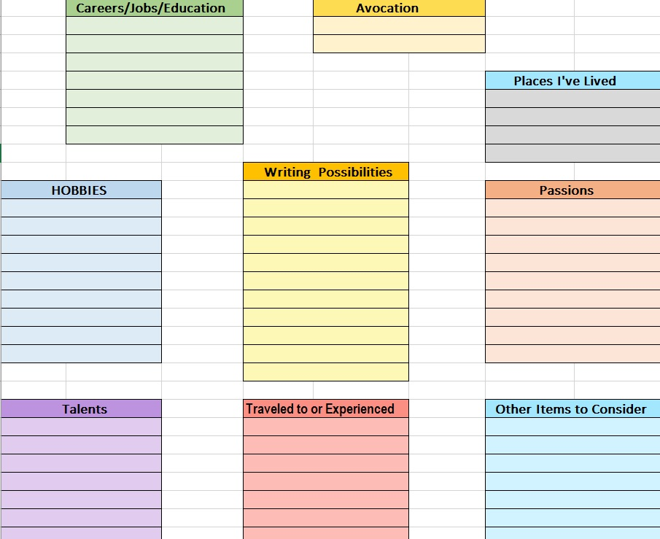
How do you find your genre(s) ?

Slide 28
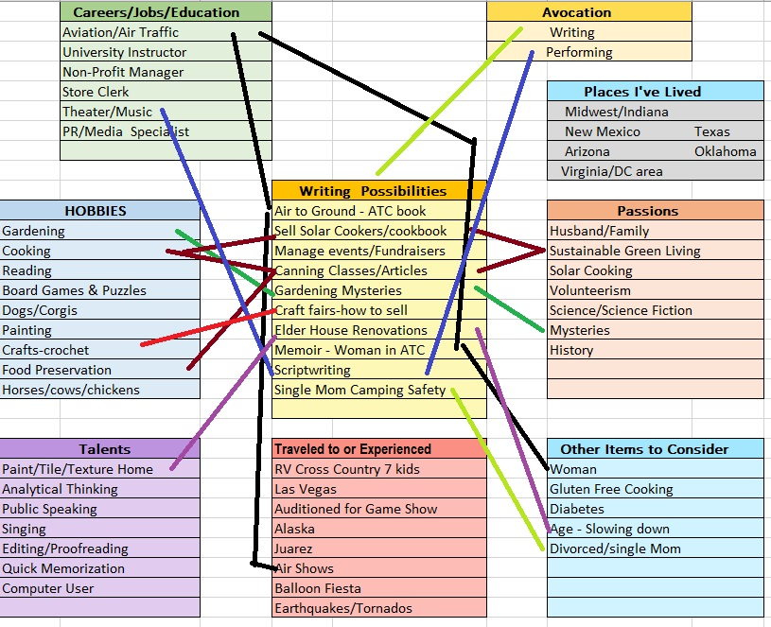
USE your K. S. A.’s!

Slide 29
Who would want to read your book? (and don’t say “everyone”)
There are different audiences for Fiction and Non-Fiction and even within those two general categories lie a wide variety of reading tastes.
Example Genre: Fantasy
Reader Preferences could be:
Culturally oriented: American, mediterranean, Nordic, Egyptian, Hindi, Oriental
Time period: Current, historical, futuristic
Tone: Dark Fantasy (zombies, vampires), Bright Fantasy (fairy princess), Post-apocalyptic
Children’s Fantasy (Peter Rabbit), Steampunk, SciFi Fantasy (Dr. Who)
Young at Heart Fantasy (Grinch Stole Christmas, Willy Wonka), Romantic Fantasy
Sexual Fantasy, Adventure Fantasy (Indiana Jones),
Knowing your audience allows you to design your marketing (and book
cover) in a style that is calculated to attract that particular group of buyers

Slide 30
Finding YOUR Target Audience?
Nonfiction
Memoir
Business, Leadership
Human Resources
Spirituality, Religion
Gardening, Solar Cooking
Crafts, Hobbies
Travel
Fiction
Short stories
Mystery, Romance, SciFi
Creative nonfiction
Adventure
Children’s Stories

Slide 31
Your Audience Means Everything
Who will be reading your book?
How will you motivate them to invest time and money in it?
How will you excite them to support it?

Slide 32
Your Audience is Your Target Market
Where are they?
How will you find them?
How will you reach them?

Slide 33
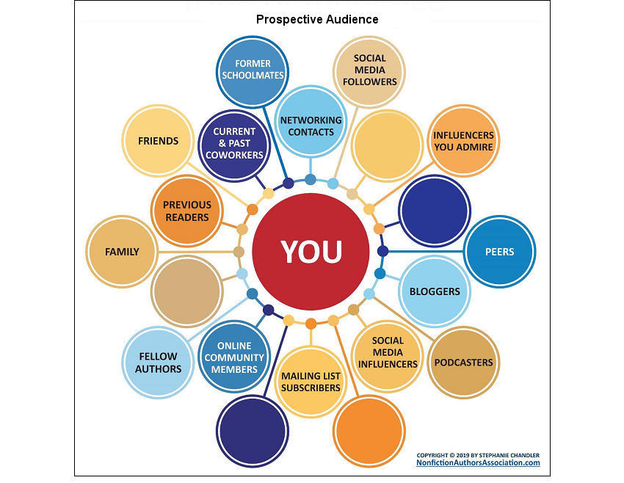
Identifying Your Audience

Slide 34
Your Audience

Slide 35
When Do We Get to the Marketing Part?
It was early in the development of a new product, and someone asked this question. I’m not sure the word “marketing” means what you think it means.
Later, we will get to the promotion and advertising part. But right now, this is marketing. All of it.
The product (book). The warranty (disclaimers & copyright). The team (editors, designers, etc.). The color choices (cover). The pricing. The way it feels in your hand. The urgency we have to tell our friends…
If you wait until you’re done (writing) before you do the marketing, you’ve waited far too long.
Seth Godin

Slide 36
How Will You Reach Your Target Market?
Advertising?
Amazon Ads
Social ads – Google, Facebook, LinkedIn
Book Publicity
External, driven by publicists and connections
Think: Press releases, media interviews and coverage
Book Marketing
Internally driven by you as the author
Prepublication
Ongoing

Slide 37
Developing Your Platform
What’s Your Platform? – your ability to reach
people who may want to buy your book
Website
Mailing List
Social Media
Prior Articles & Short Stories
Speaking
Your Platform is your credibility

Slide 38
Exercise: Your Author’s Platform

Slide 39
Prepublication
Discovery
Establish your Platform and Website
Metadata
Keywords
Book Title
Book Description
Author’s Name

Slide 40
Ongoing Marketing
Website/social media updates
Newsletters
Blogs — your own & guest posts
Podcasts & webinars
Personal appearances – speaking and book signings
Articles & short stories
Magazines, on-line platforms, self-publish
Enter short story contests

Slide 41
Launch Plan
Presales and preorders
Sales Pages: Amazon, B&N, Indiebound.org
Claim your book on Goodreads
Amazon Author’s Page – Author Central
Claim your book after the sales page posts.
Visit http://AuthorCentral.Amazon.com.
Reviewers (including Amazon reviews)
Sample launch plan included on handout

Slide 42
Oh, those pesty Business Details
Gross Receipts Taxes or Sales Taxes
Income and income taxes
Track your deductible expenses
IRS Form Schedule C for business income and expenses
Business Structure? (Why are your writing?)
Sole proprietorship, partnership, LLC?
Do you need to form an limited liability corporation (LLC)?
Legal and tax implications.
Copyrights – Liabilities
Get professional advice.

Slide 43
Oh, those pesty Technical Details
Software for writing
MS Word
Pages (Mac); Google Docs; Indesign
Adobe (Acrobat)
Software for tracking expenses
Excel
Quick Books
Microsoft Money

Slide 44
Resources
Sage Newsletter
30 years of writing advice
Writer’s Digest (writersdigest.com)
Paper magazine, on-line articles, daily emails
Build Book Buzz (buildbookbuzz.com) – Sandra Beckwith
Blogs & newsletters about book marketing
BookBaby (blog.bookbaby.com)
Blogs about all things publishing
The Writer’s Market Book (ebook or paper)
Author’s Publish (authorspubish.com)
Jane Friedman (janefriedman.com)

Slide 45
Life-Long Learning
Practice and study your craft
Associate with other writers
Learn about the industry
Read stories/books by other authors in your genre
Read articles/essays by others
Read writer’s magazines and journals
Read books about writing
Attend conferences, classes, seminars, webinars
Check out writer’s groups on Facebook and social media

Slide 46
Closing Thoughts
Plan early
Do your research
Talk with other authors
Ask them what works for them and WHY
There is no right answer
Different things work for each author
Analyze your efforts
Do more of what’s working for you

